Slide 1
Union-Find by rank with path compression

Slide 2
Design an algorithm that can perform the following operations:
1) Make-Singleton(u): Make a single node u
2)Union(u,v): Add edge (u,v)
3)Find(u): Return the unique identifier of the tree that
contains u

Slide 3





Union Find
Union
Find
O($n\log{n}$) over all n-1 union
O($\log{n}$) per union
O($1$) per find
O($\log{n}$) per find
Can we design an algorithm with constant union time and find?
Not possible but we get nearly constant time
Hopcroft and Ullman [1973] $\log^{∗}{n}$
Robert Tarjan[1975] $α(n)$
Fredman and Saks[1989] $Ω(α\left(n\right))$

Slide 4
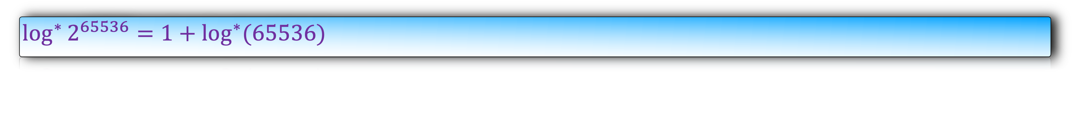

The iterated logarithm of a number, log* n, is the number of times the logarithm function must be iteratively applied before the result is less than or equal to 1.
$0$ if $n≤1$
$\log^{∗}{n}$ =
$1+\log^{∗}{(log{n})}$ otherwise
$\log^{∗}{2^{65536}}=1+\log^{∗}(65536)$

Slide 5
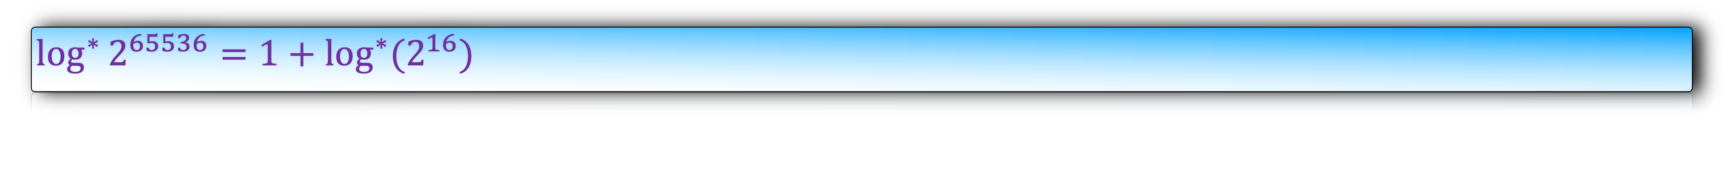

The iterated logarithm of a number, log* n, is the number of times the logarithm function must be iteratively applied before the result is less than or equal to 1.
$0$ if $n≤1$
$\log^{∗}{n}$ =
$1+\log^{∗}{(log{n})}$ otherwise
$\log^{∗}{2^{65536}}=1+\log^{∗}(2^{16})$

Slide 6
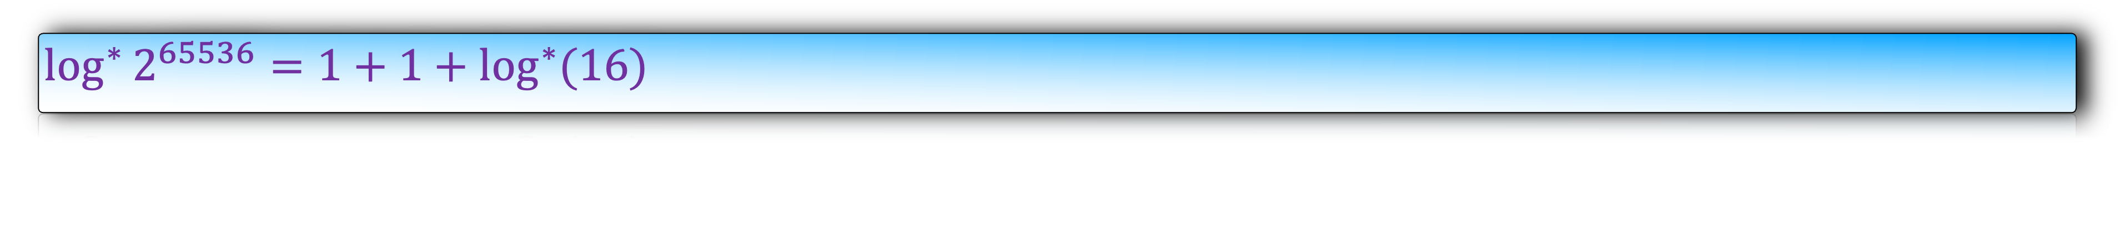
The iterated logarithm of a number, log* n, is the number of times the logarithm function must be iteratively applied before the result is less than or equal to 1.
$0$ if $n≤1$
$\log^{∗}{n}$ =
$1+\log^{∗}{(log{n})}$ otherwise
$\log^{∗}{2^{65536}}=1+1+\log^{∗}(16)$

Slide 7
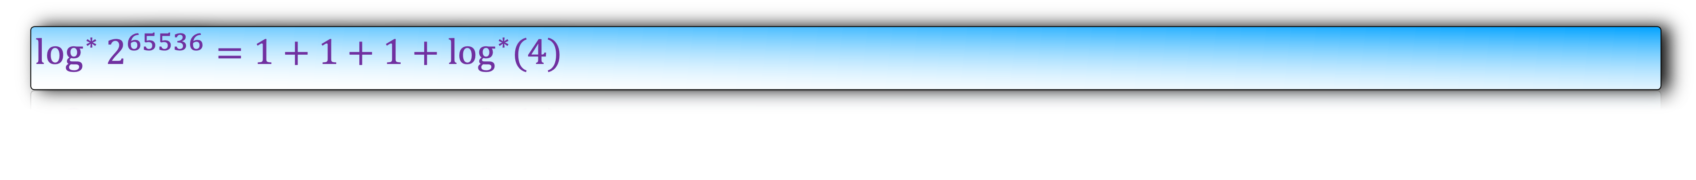
The iterated logarithm of a number, log* n, is the number of times the logarithm function must be iteratively applied before the result is less than or equal to 1.
$0$ if $n≤1$
$\log^{∗}{n}$ =
$1+\log^{∗}{(log{n})}$ otherwise
$\log^{∗}{2^{65536}}=1+1+1+\log^{∗}(4)$

Slide 8
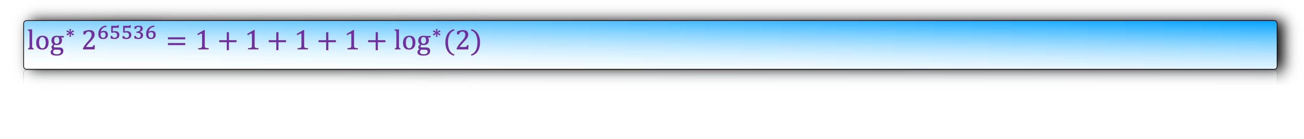
The iterated logarithm of a number, log* n, is the number of times the logarithm function must be iteratively applied before the result is less than or equal to 1.
$0$ if $n≤1$
$\log^{∗}{n}$ =
$1+\log^{∗}{(log{n})}$ otherwise
$\log^{∗}{2^{65536}}=1+1+1+1+\log^{∗}(2)$

Slide 9
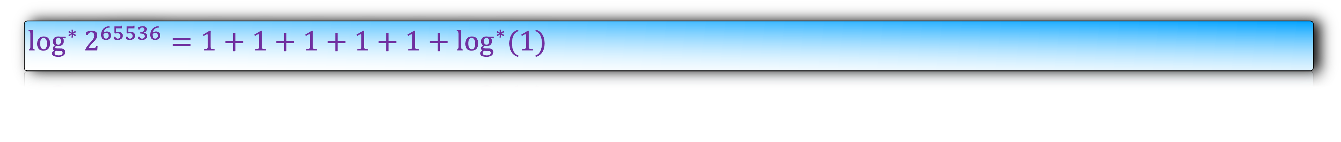
The iterated logarithm of a number, log* n, is the number of times the logarithm function must be iteratively applied before the result is less than or equal to 1.
$0$ if $n≤1$
$\log^{∗}{n}$ =
$1+\log^{∗}{(log{n})}$ otherwise
$\log^{∗}{2^{65536}}=1+1+1+1+1+\log^{∗}(1)$

Slide 10
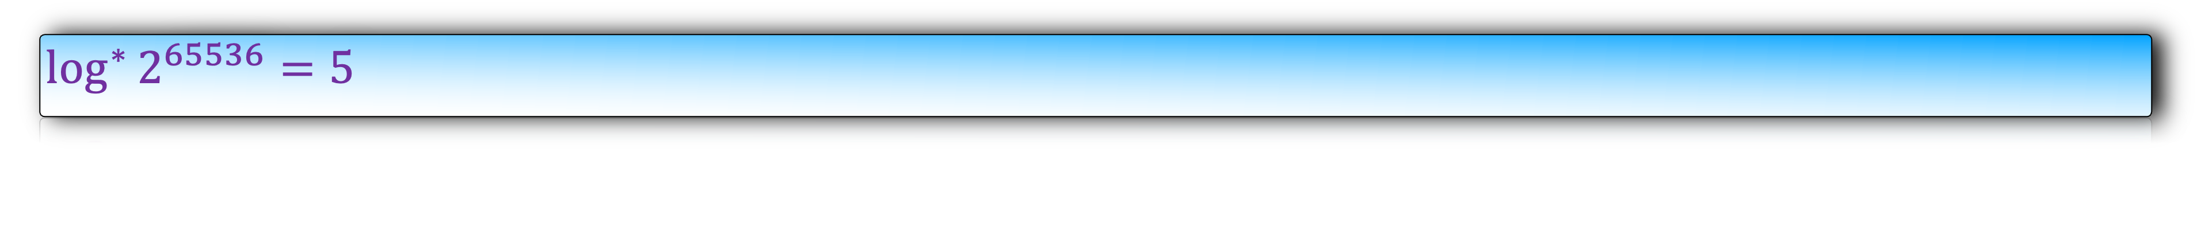
The iterated logarithm of a number, log* n, is the number of times the logarithm function must be iteratively applied before the result is less than or equal to 1.
$0$ if $n≤1$
$\log^{∗}{n}$ =
$1+\log^{∗}{(log{n})}$ otherwise
$\log^{∗}{2^{65536}}=5$
log*n is a very slow growing function.
For all practical purpose, log*n is less than 6.

Slide 11
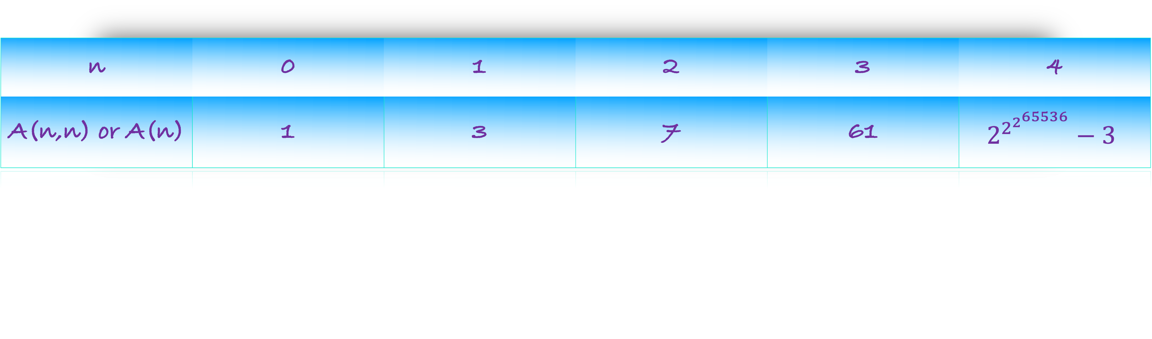
Ackerman Function
m+1 when n=0
A(n,m) = A(n-1,1) when n>0,m=0
A(n-1,A(n,m-1)) otherwise
This function has explosive growth.
n | 0 | 1 | 2 | 3 | 4
A(n,n) or A(n) | 1 | 3 | 7 | 61 | $$2^{2^{2^{65536}}}−3$$

Slide 12

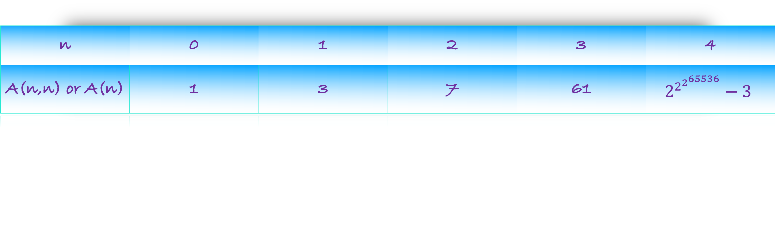
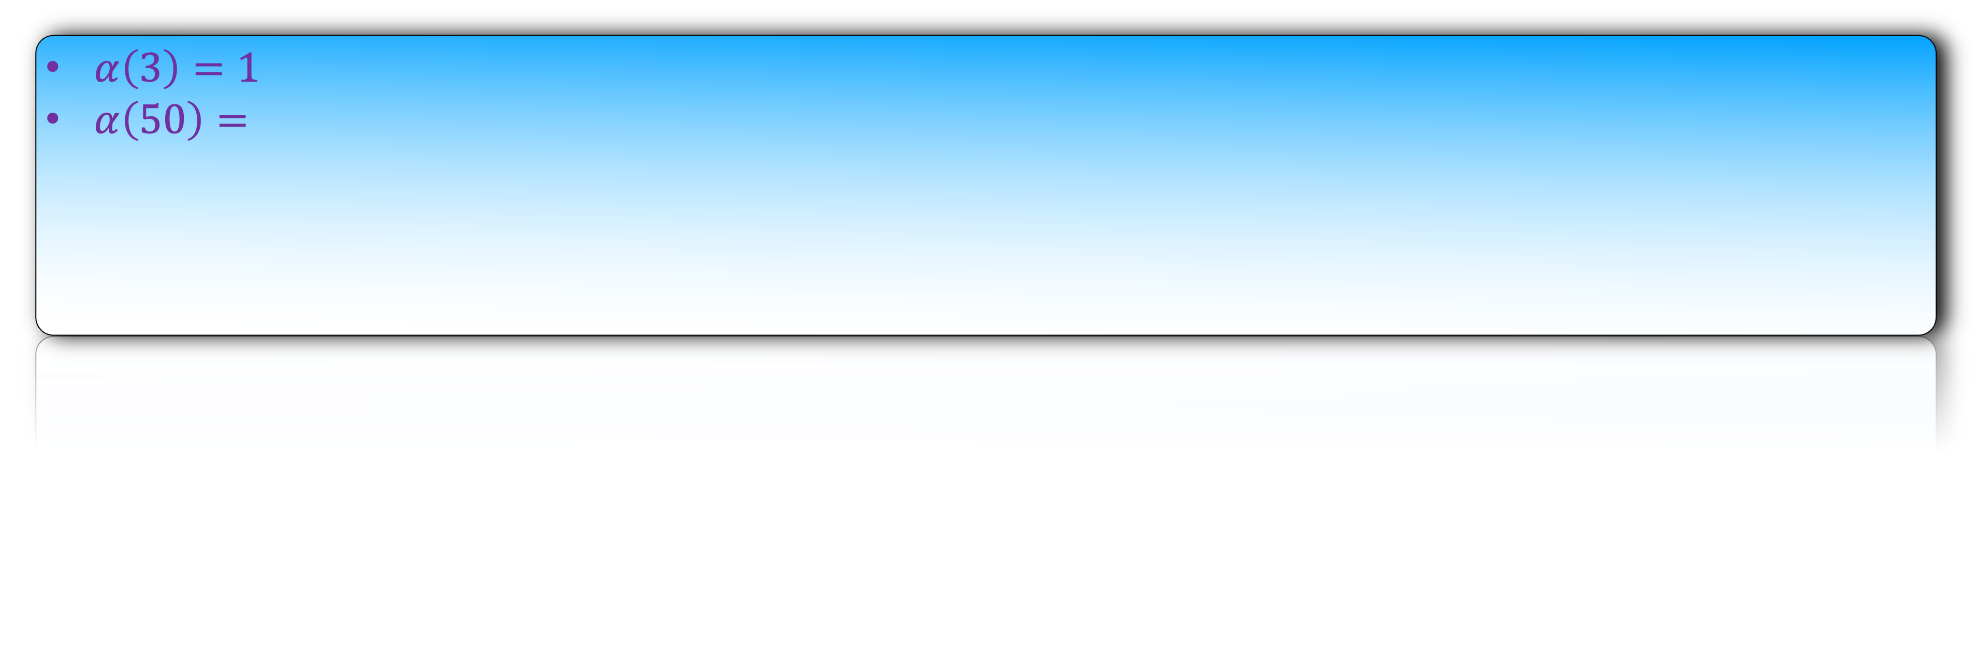
This function has explosive growth.
n | 0 | 1 | 2 | 3 | 4
A(n,n) or A(n) | 1 | 3 | 7 | 61 | $$2^{2^{2^{65536}}}−3$$
Inverse Ackerman Function
$$α\left(n\right)=min⁡\{k such that A\left(k\right)≥n\}$$
$α\left(3\right)=1$
$α\left(50\right)=$

Slide 13
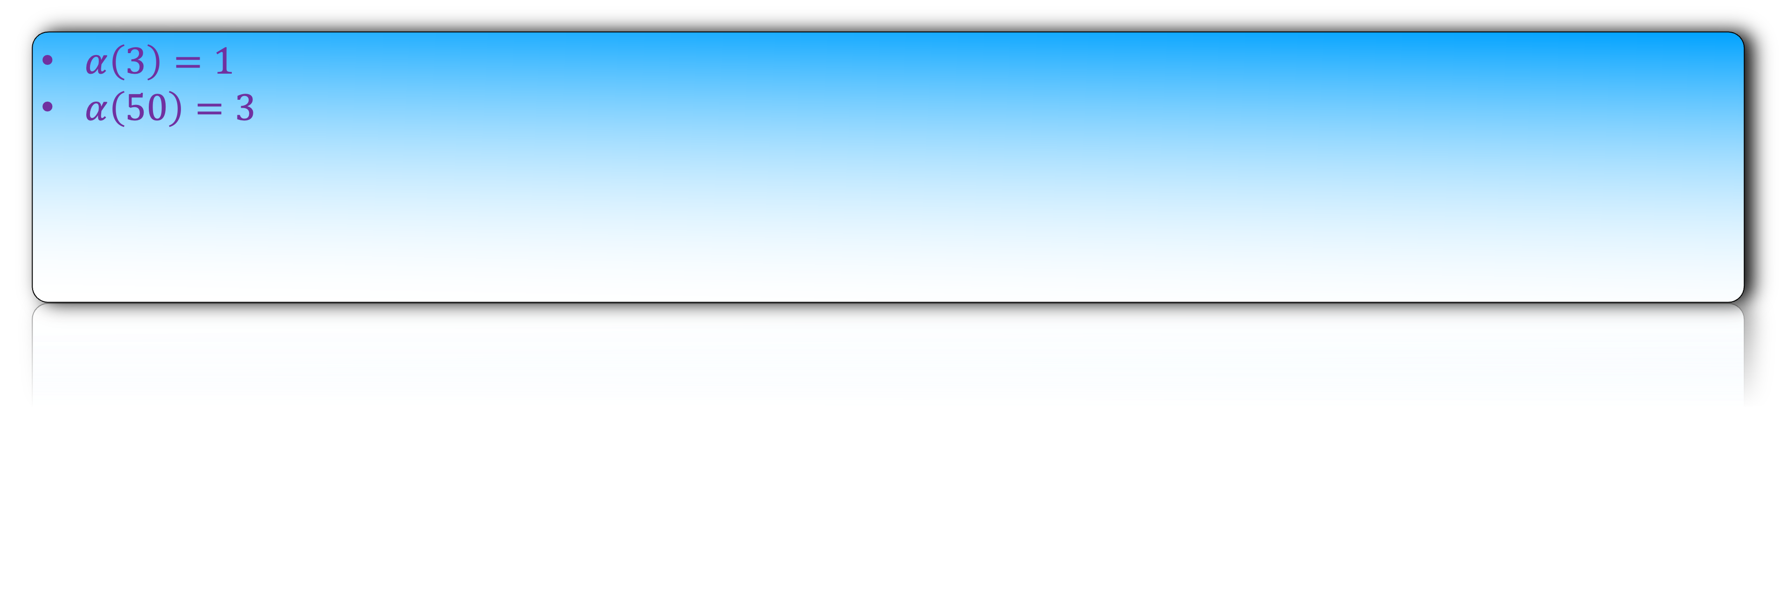
This function has explosive growth.
n | 0 | 1 | 2 | 3 | 4
A(n,n) or A(n) | 1 | 3 | 7 | 61 | $$2^{2^{2^{65536}}}−3$$
Inverse Ackerman Function
$$α\left(n\right)=min⁡\{k such that A\left(k\right)≥n\}$$
$α\left(3\right)=1$
$α\left(50\right)=3$

Slide 14
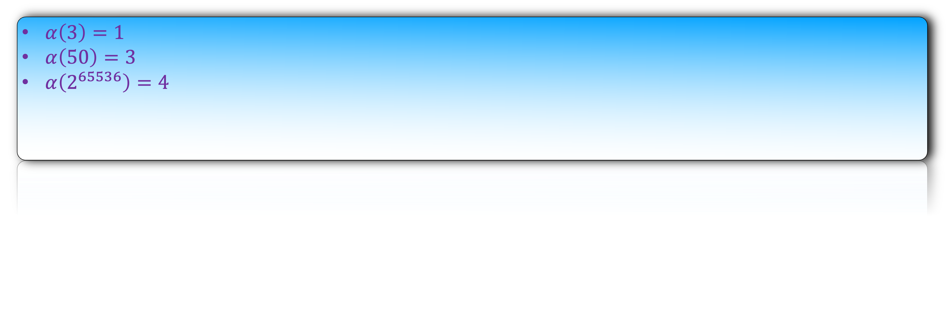
This function has explosive growth.
n | 0 | 1 | 2 | 3 | 4
A(n,n) or A(n) | 1 | 3 | 7 | 61 | $$2^{2^{2^{65536}}}−3$$
Inverse Ackerman Function
$$α\left(n\right)=min⁡\{k such that A\left(k\right)≥n\}$$
$α\left(3\right)=1$
$α\left(50\right)=3$
$α\left(2^{65536}\right)=4$

Slide 15

Inverse Ackerman Function
$$α\left(n\right)=min⁡\{k such that A\left(k\right)≥n\}$$
It is remarkable that such a function occurs naturally as the answer to an algorithmic question.
That is why union-find is one of the most important data-structure problem.

Slide 16


Slide 17
But in this lecture, we will only prove that m union/find operations take
O((m+n) log* n) time.

Slide 18
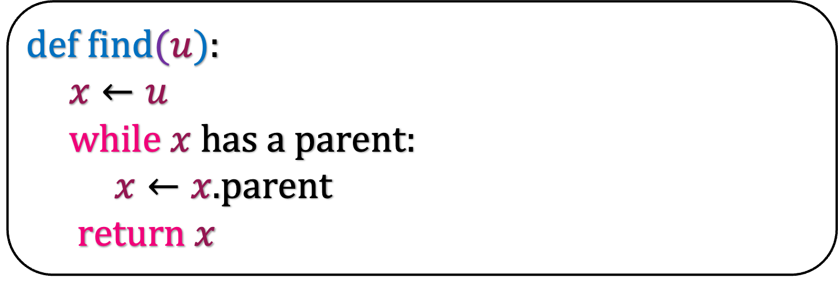
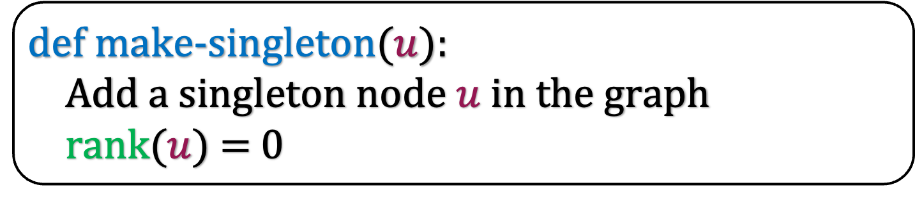
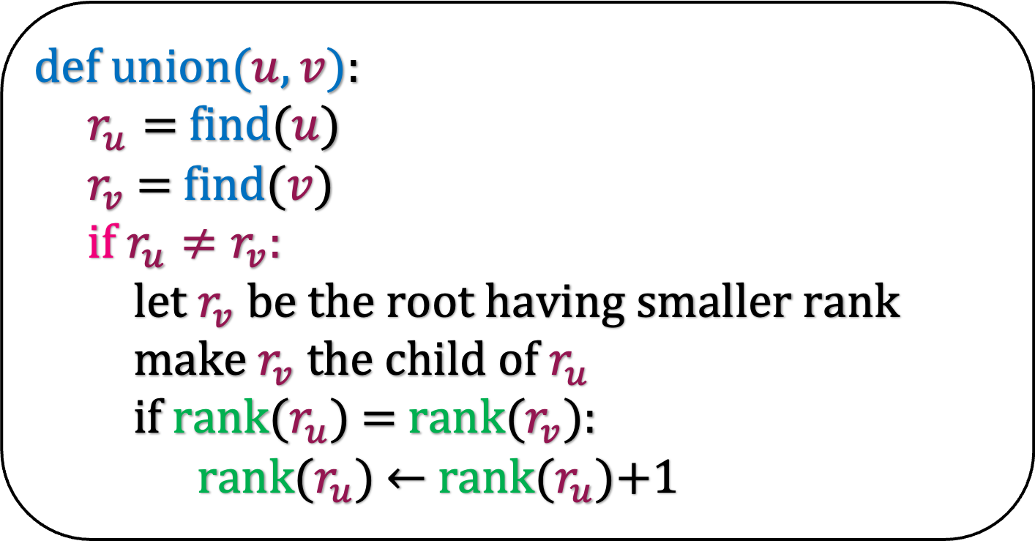
Path Compression
def make-singleton($u$):
Add a singleton node $u$ in the graph
rank$(u)$ = 0
Remember our union-find algorithm.
Specifically look at the find algorithm.
def find$(u$):
$x←u$
while $x$ has a parent:
$x←x.$parent
return $x$
def u$nion(u,v$):
$r_{u}=$find($u$)
$r_{v}$ = find($v$)
if $r_{u}≠r_{v}:$
let $r_{v}$ be the root having smaller rank
make $r_{v}$ the child of $r_{u}$
if rank($r_{u}$) $=$ rank($r_{v}$):
rank($r_{u}$) $←$ rank($r_{u}$)+1

Slide 19
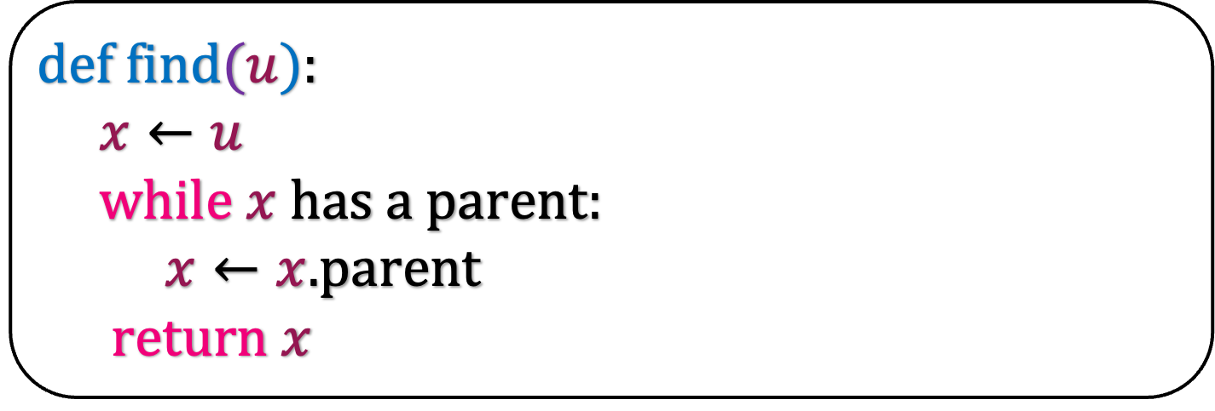
Path Compression
Remember our union-find algorithm.
Specifically look at the find algorithm.
There is a simple heuristic that enhances this find function.
def find$(u$):
$x←u$
while $x$ has a parent:
$x←x.$parent
return $x$

Slide 20

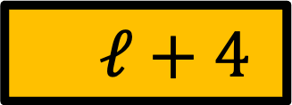



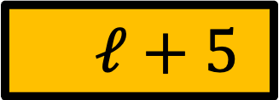
Path Compression
1
def find$(u$):
$x←u$
while $x$ has a parent:
$x←x.$parent
return $x$
1
a
$ℓ+5$
b
$ℓ+4$
c
$ℓ+3$
d
$ℓ+2$
e
$ℓ+1$
u
$ℓ$

Slide 21
Path Compression
1
def find$(u$):
$x←u$
while $x$ has a parent:
$x←x.$parent
return $x$
1
a
$ℓ+5$
b
$ℓ+4$
c
$ℓ+3$
d
$ℓ+2$
e
$ℓ+1$
u
$ℓ$

Slide 22
Path Compression
1
def find$(u$):
$x←u$
while $x$ has a parent:
$x←x.$parent
return $x$
1
a
$ℓ+5$
b
$ℓ+4$
c
$ℓ+3$
Why not make u,e,d,c the child of a?
This will reduce the running time of future find operations.
d
$ℓ+2$
e
$ℓ+1$
u
$ℓ$

Slide 23
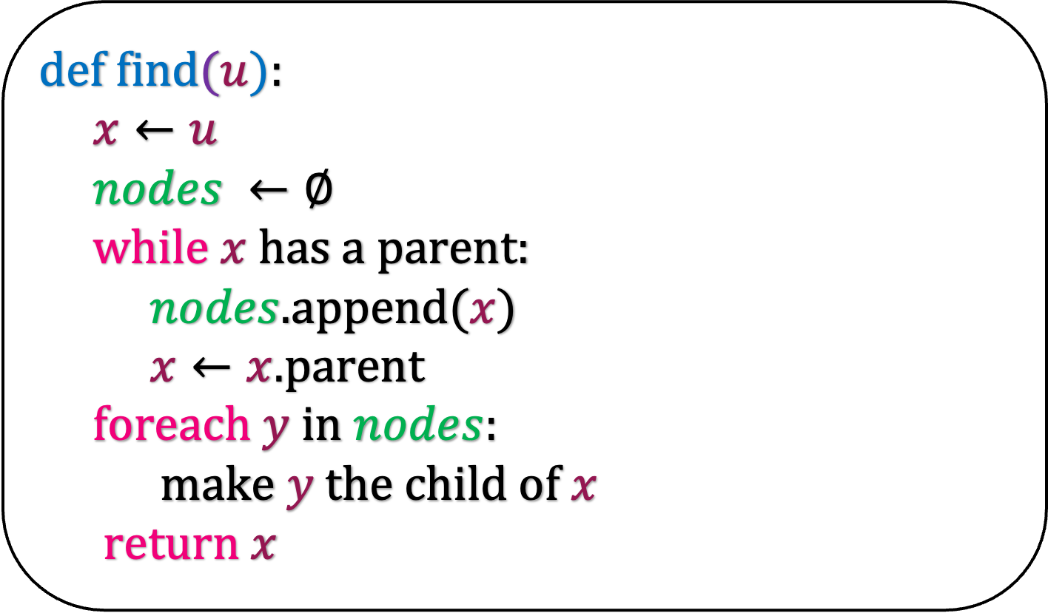
Path Compression
def find$(u$):
$x←u$
$nodes ←∅$
while $x$ has a parent:
$nodes$.append($x$)
$x←x.$parent
foreach $y$ in $nodes$:
make $y$ the child of $x$
return $x$
1
1
a
$ℓ+5$
b
$ℓ+4$
c
$ℓ+3$
d
$ℓ+2$
e
$ℓ+1$
u
$ℓ$

Slide 24
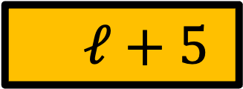

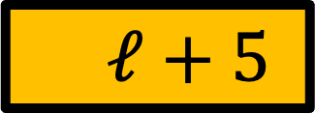


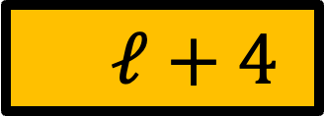





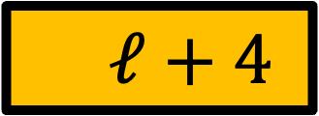
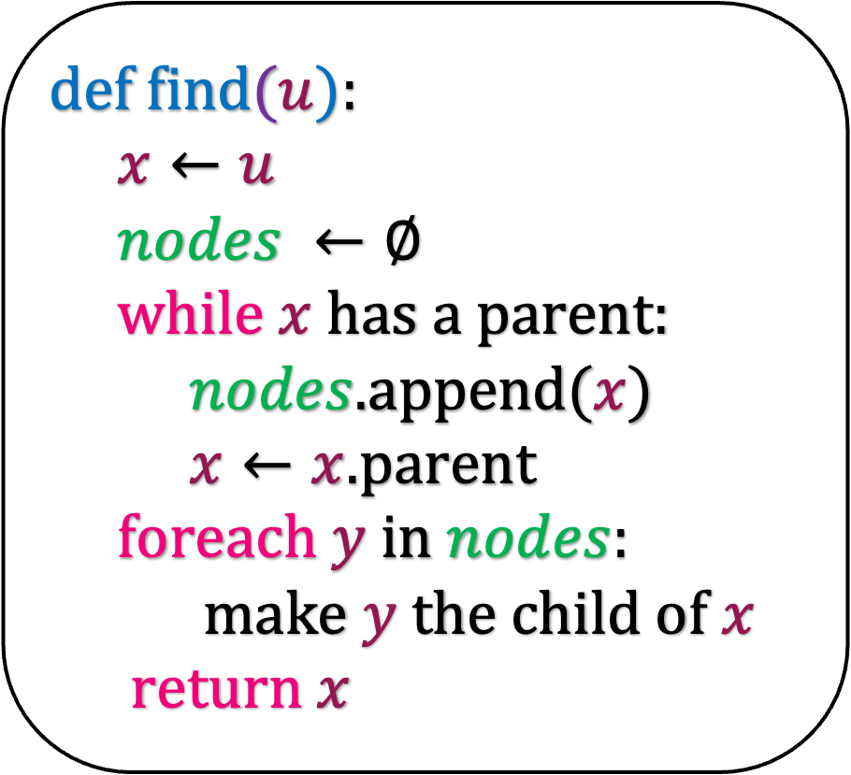
Path Compression
1
1
a
$ℓ+5$
1
1
a
$ℓ+5$
b
$ℓ+4$
b
$ℓ+4$
c
$ℓ+3$
c
$ℓ+3$
d
$ℓ+2$
e
$ℓ+1$
d
$ℓ+2$
u
$ℓ$
def find$(u$):
$x←u$
$nodes ←∅$
while $x$ has a parent:
$nodes$.append($x$)
$x←x.$parent
foreach $y$ in $nodes$:
make $y$ the child of $x$
return $x$
e
$ℓ+1$
u
$ℓ$

Slide 25
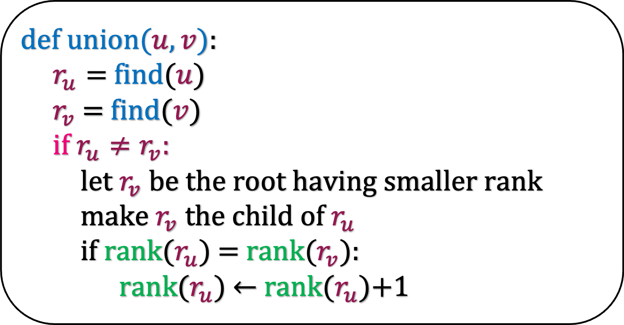

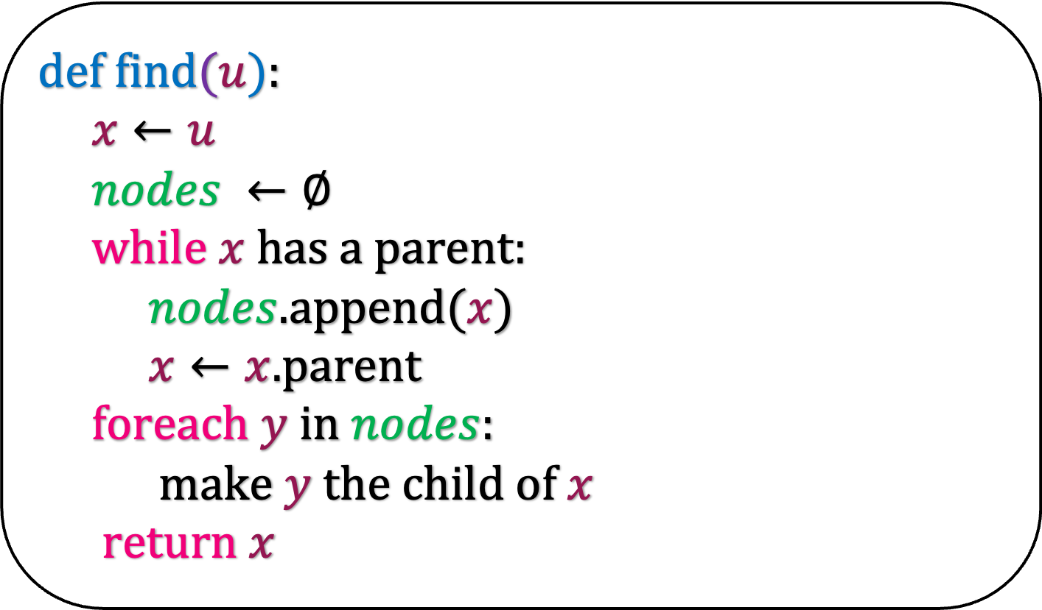
Path Compression
def make-singleton($u$):
Add a singleton node $u$ in the graph
rank$(u)$ = 0
This is the path compression technique.
For starters, it just looks like a heuristic and nothing more.
But as we will see later, it improves the running time dramatically.
def find$(u$):
$x←u$
$nodes ←∅$
while $x$ has a parent:
$nodes$.append($x$)
$x←x.$parent
foreach $y$ in $nodes$:
make $y$ the child of $x$
return $x$
def u$nion(u,v$):
$r_{u}=$find($u$)
$r_{v}$ = find($v$)
if $r_{u}≠r_{v}:$
let $r_{v}$ be the root having smaller rank
make $r_{v}$ the child of $r_{u}$
if rank($r_{u}$) $=$ rank($r_{v}$):
rank($r_{u}$) $←$ rank($r_{u}$)+1

Slide 26
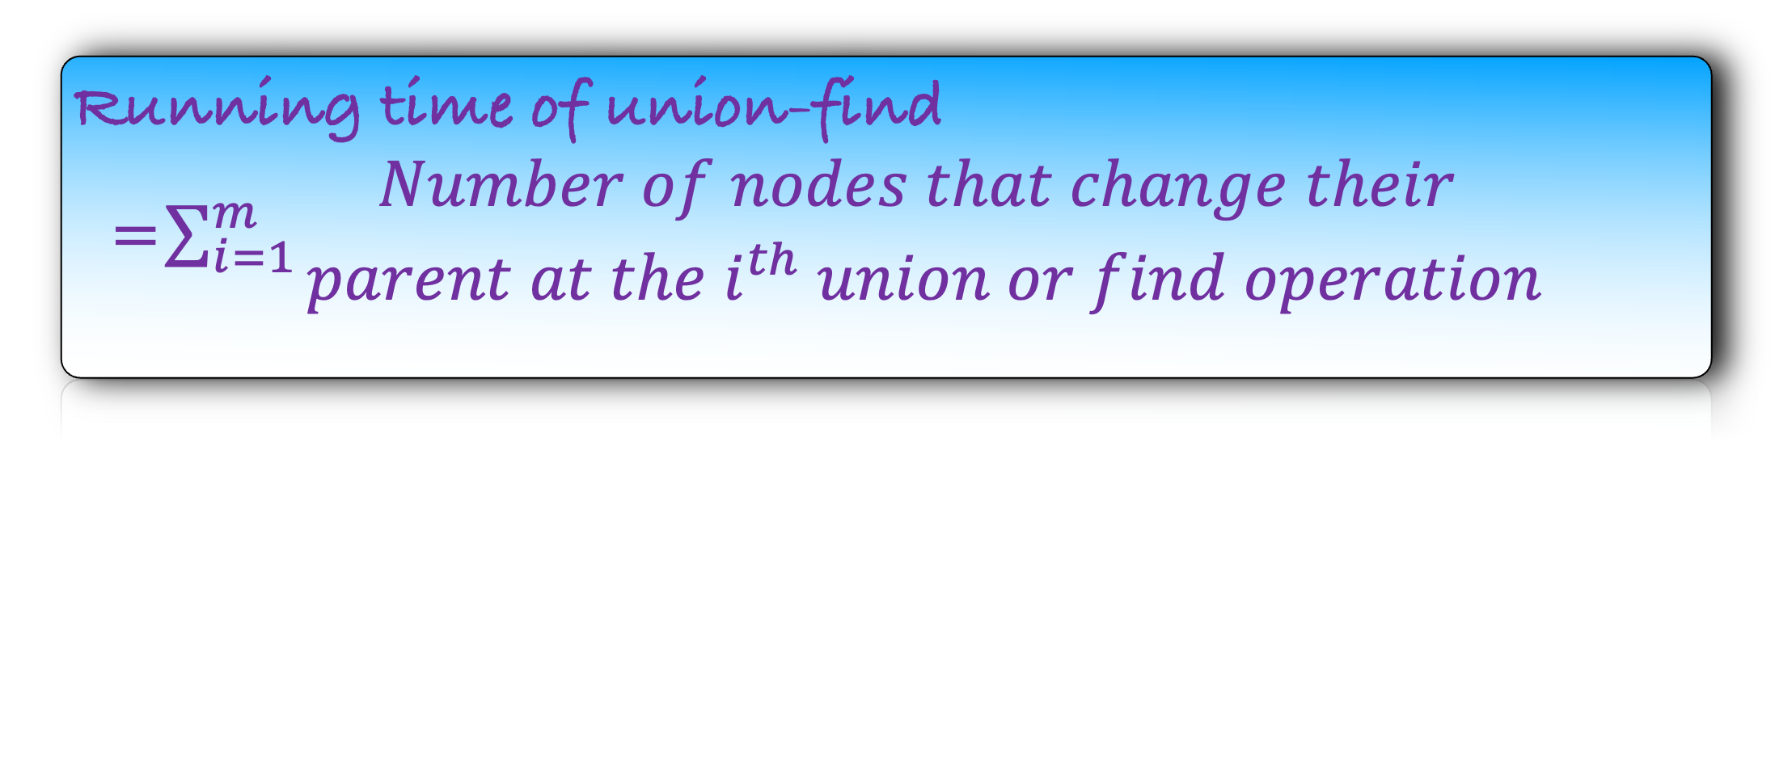
Bounding the Running Time
We just need to bound the running time of find.
The running time is directly proportional to the number of nodes that change their parent.
So, we just need to calculate how many times a node can change their parent over m union-find operations
def make-singleton($u$):
Add a singleton node $u$ in the graph
rank$(u)$ = 0
def find$(u$):
$x←u$
$nodes ←∅$
while $x$ has a parent:
$nodes$.append($x$)
$x←x.$parent
foreach $y$ in $nodes$:
make $y$ the child of $x$
return $x$
Running time of union-find
=$\sum_{i=1}^{m}{\begin{aligned}Number of nodes that change their \\ parent at the i^{th} union or find operation\end{aligned}}$
def u$nion(u,v$):
$r_{u}=$find($u$)
$r_{v}$ = find($v$)
if $r_{u}≠r_{v}:$
let $r_{v}$ be the root having smaller rank
make $r_{v}$ the child of $r_{u}$
if rank($r_{u}$) $=$ rank($r_{v}$):
rank($r_{u}$) $←$ rank($r_{u}$)+1
How many times can a node change its parent?

Slide 27


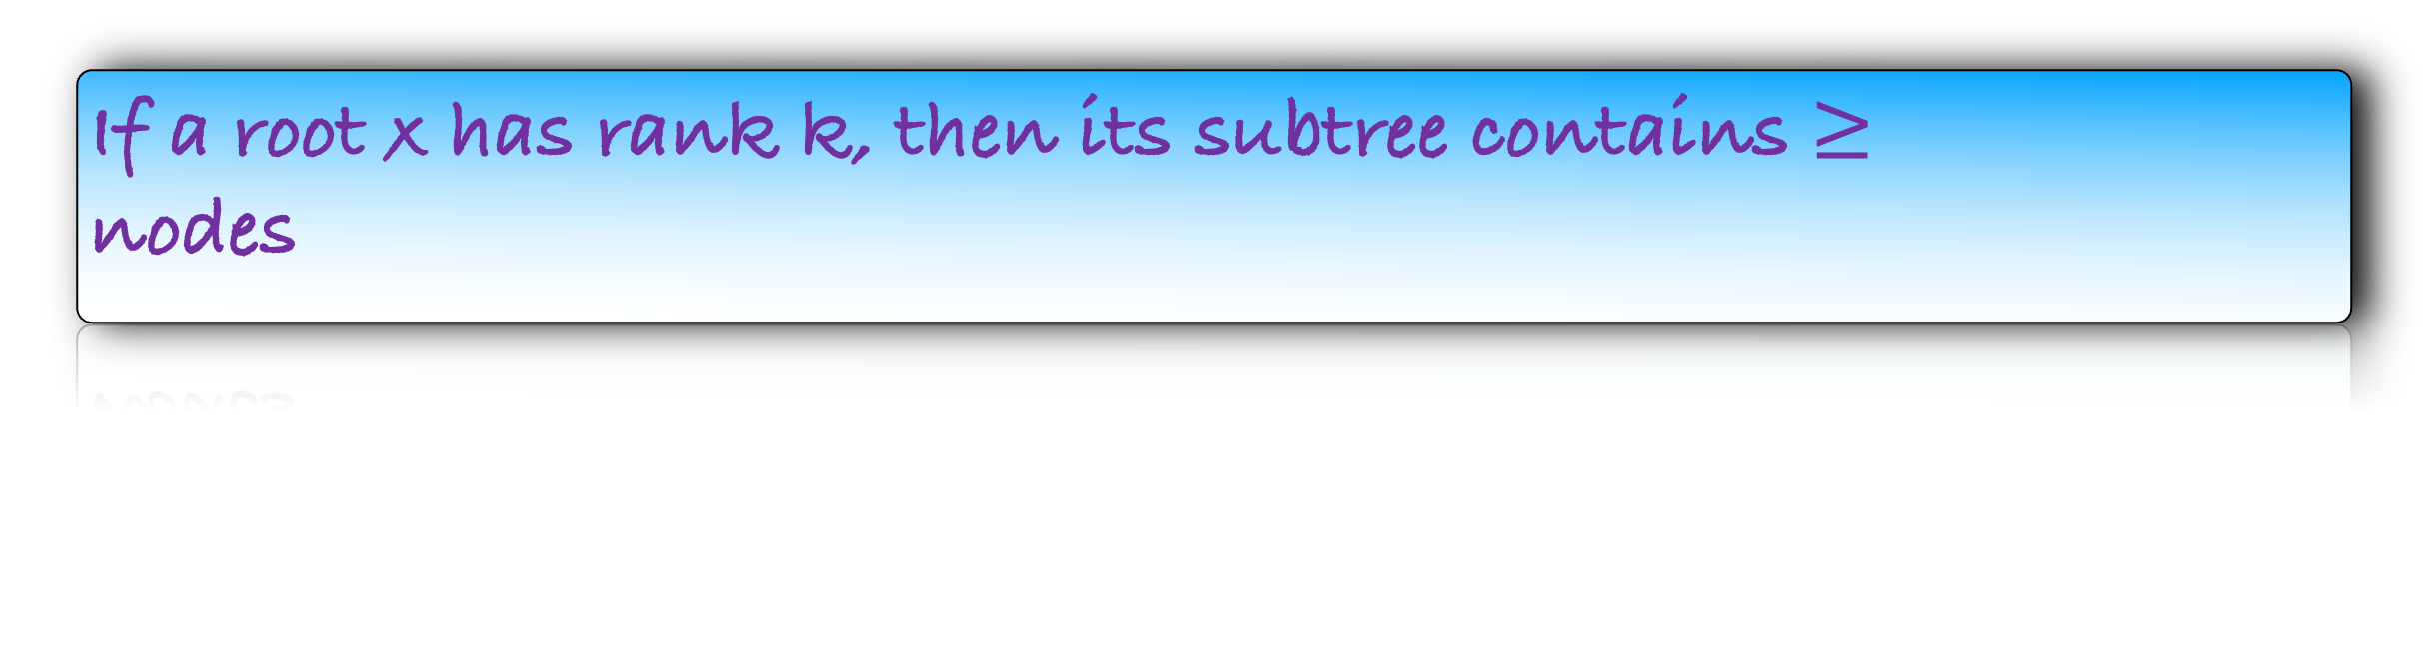


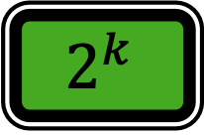
Path Compression
def make-singleton($u$):
Add a singleton node $u$ in the graph
rank$(u)$ = 0
Recall our observations
Once a node becomes a non-root, it become root again
cannot
def find$(u$):
$x←u$
$nodes ←∅$
while $x$ has a parent:
$nodes$.append($x$)
$x←x.$parent
foreach $y$ in $nodes$:
make $y$ the child of $x$
return $x$
Once a node become non-root, its rank increase
cannot
If x is not a root node, rank(x) rank(x.parent)
$$<$$
If a root x has rank k, then its subtree contains $≥$
nodes
$$2^{k}$$
Maximum rank of a root is
def u$nion(u,v$):
$r_{u}=$find($u$)
$r_{v}$ = find($v$)
if $r_{u}≠r_{v}:$
let $r_{v}$ be the root having smaller rank
make $r_{v}$ the child of $r_{u}$
if rank($r_{u}$) $=$ rank($r_{v}$):
rank($r_{u}$) $←$ rank($r_{u}$)+1
$$\log{n}$$
How many times can a node change its parent?
$$\log{n}$$
Or may be much better

Slide 28
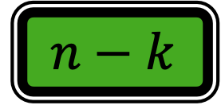
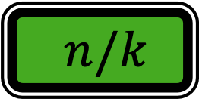

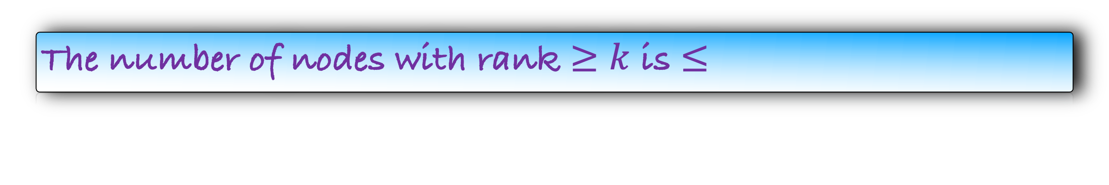
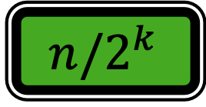
Path Compression
def make-singleton($u$):
Add a singleton node $u$ in the graph
rank$(u)$ = 0
Recall our observations
Once a node becomes a non-root, it become root again
cannot
def find$(u$):
$x←u$
$nodes ←∅$
while $x$ has a parent:
$nodes$.append($x$)
$x←x.$parent
foreach $y$ in $nodes$:
make $y$ the child of $x$
return $x$
Once a node become non-root, its rank increase
cannot
If x is not a root node, rank(x) rank(x.parent)
$$<$$
If a root x has rank k, then its subtree contains $≥$
nodes
$$2^{k}$$
Maximum rank of a root is
def u$nion(u,v$):
$r_{u}=$find($u$)
$r_{v}$ = find($v$)
if $r_{u}≠r_{v}:$
let $r_{v}$ be the root having smaller rank
make $r_{v}$ the child of $r_{u}$
if rank($r_{u}$) $=$ rank($r_{v}$):
rank($r_{u}$) $←$ rank($r_{u}$)+1
$$\log{n}$$
The number of nodes with rank $≥k$ is $≤$
$k$
$n/k$
$$n−k$$
$$n/2^{k}$$
??

Slide 29
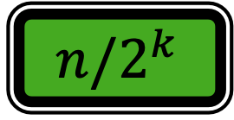
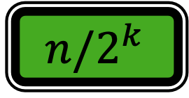
Path Compression
def make-singleton($u$):
Add a singleton node $u$ in the graph
rank$(u)$ = 0
Recall our observations
Once a node becomes a non-root, it become root again
cannot
def find$(u$):
$x←u$
$nodes ←∅$
while $x$ has a parent:
$nodes$.append($x$)
$x←x.$parent
foreach $y$ in $nodes$:
make $y$ the child of $x$
return $x$
Once a node become non-root, its rank increase
cannot
If x is not a root node, rank(x) rank(x.parent)
$$<$$
If a root x has rank k, then its subtree contains $≥$
nodes
$$2^{k}$$
Maximum rank of a root is
def u$nion(u,v$):
$r_{u}=$find($u$)
$r_{v}$ = find($v$)
if $r_{u}≠r_{v}:$
let $r_{v}$ be the root having smaller rank
make $r_{v}$ the child of $r_{u}$
if rank($r_{u}$) $=$ rank($r_{v}$):
rank($r_{u}$) $←$ rank($r_{u}$)+1
$$\log{n}$$
The number of nodes with rank $≥k$ is $≤$
$$n/2^{k}$$
$$n/2^{k}$$
We will prove this later

Slide 30
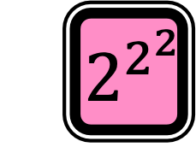

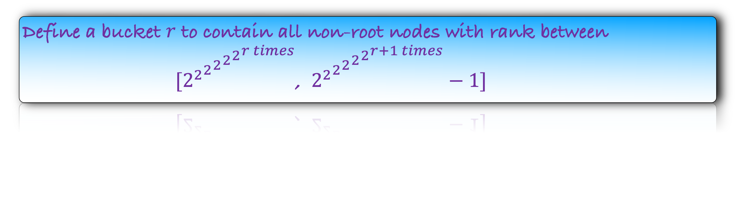
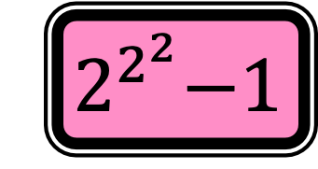
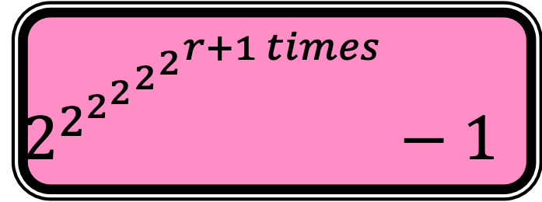
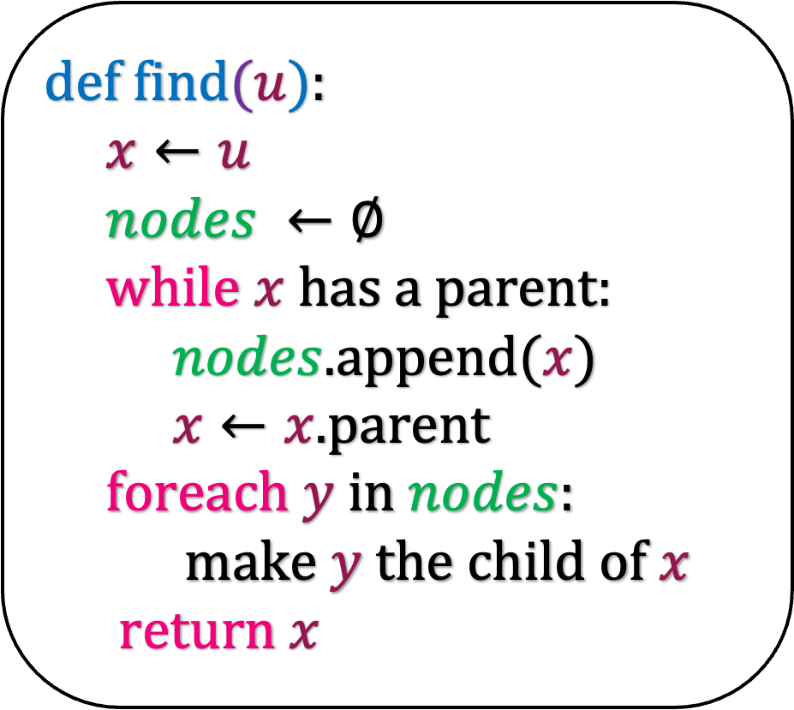
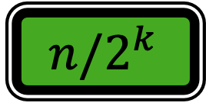

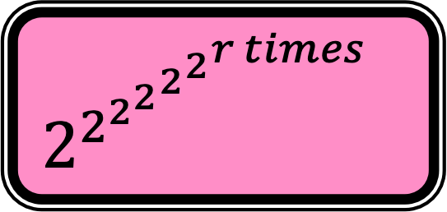
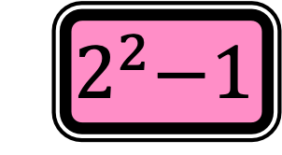
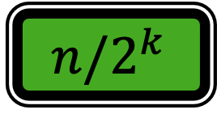


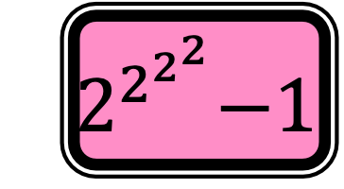
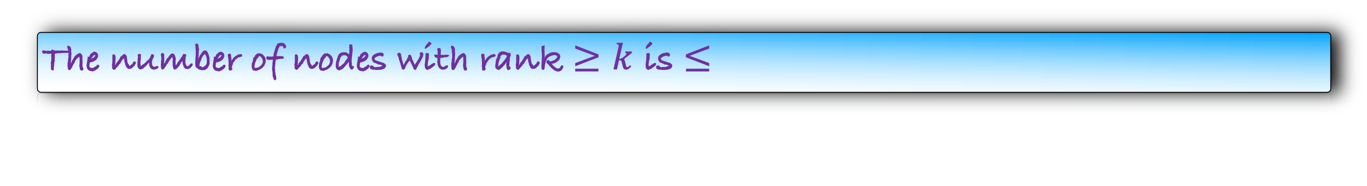
def find$(u$):
$x←u$
$nodes ←∅$
while $x$ has a parent:
$nodes$.append($x$)
$x←x.$parent
foreach $y$ in $nodes$:
make $y$ the child of $x$
return $x$
The number of nodes with rank $≥k$ is $≤$
$$n/2^{k}$$
$$n/2^{k}$$
Define a bucket $r$ to contain all non-root nodes with rank between
$[{{{{{2^{2}}^{2}}^{2}}^{2}}^{2}}^{r times}$, ${{{{{2^{2}}^{2}}^{2}}^{2}}^{2}}^{r+1 times}−1]$
$$2^{2^{{{{2^{2}}^{2}}^{2}}^{r+1 times}}}−1$$
$${ 2}^{2}−1$$
$${ 2}^{2^{2}}−1$$
$${ 2}^{2^{2^{2}}}−1$$
Bucket
Bucket 0
Bucket 1
Bucket 2
Bucket $r$
………
Rank
$$0$$
$${ 2}^{2}$$
$${ 2}^{2^{2}}$$
$$2^{2^{{{{2^{2}}^{2}}^{2}}^{r times}}}$$
How many buckets are there?
$$\log^{∗}{n}$$

Slide 31

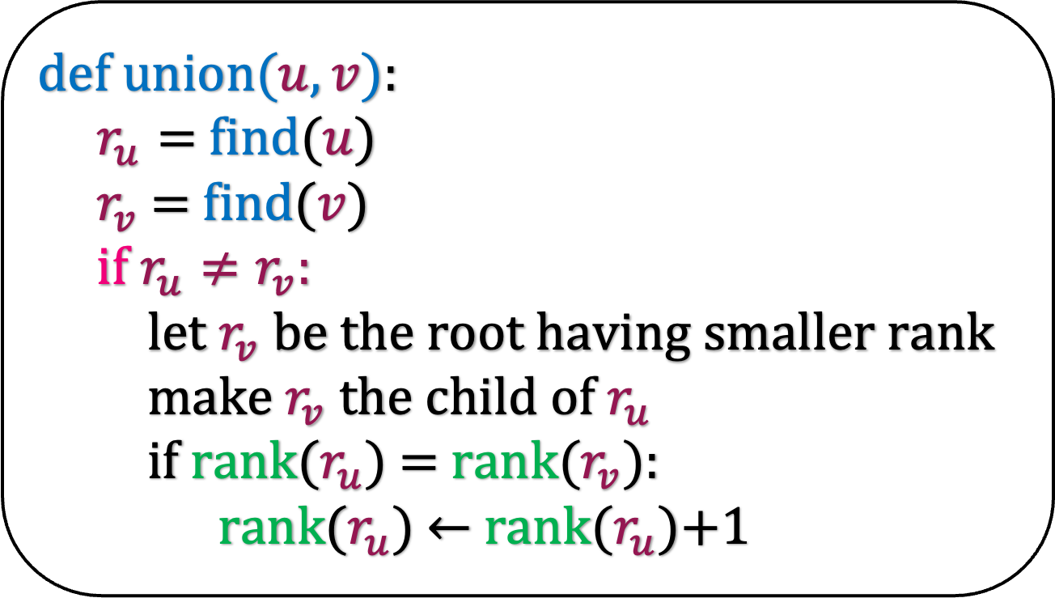
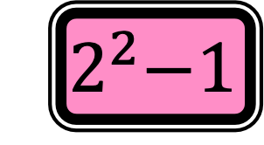






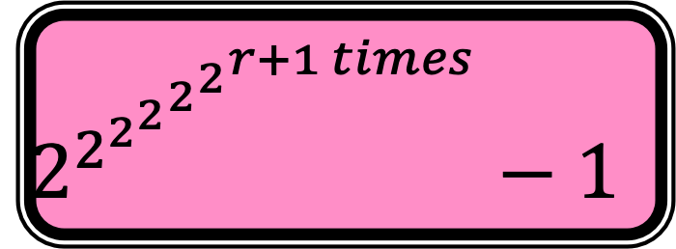

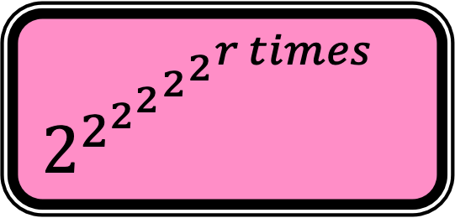
$$2^{2^{{{{2^{2}}^{2}}^{2}}^{r+1 times}}}−1$$
$${ 2}^{2}−1$$
$${ 2}^{2^{2}}−1$$
$${ 2}^{2^{2^{2}}}−1$$
Let us see now how nodes are partitioned into buckets.
Bucket 0
Bucket 1
Bucket 2
Bucket $r$
………
$$0$$
$${ 2}^{2}$$
$${ 2}^{2^{2}}$$
$$2^{2^{{{{2^{2}}^{2}}^{2}}^{r times}}}$$
u
2
def u$nion(u,v$):
$r_{u}=$find($u$)
$r_{v}$ = find($v$)
if $r_{u}≠r_{v}:$
let $r_{v}$ be the root having smaller rank
make $r_{v}$ the child of $r_{u}$
if rank($r_{u}$) $=$ rank($r_{v}$):
rank($r_{u}$) $←$ rank($r_{u}$)+1
v
2
$${ 2}^{2}$$
$${ 2}^{2}$$

Slide 32

$$2^{2^{{{{2^{2}}^{2}}^{2}}^{r+1 times}}}−1$$
$${ 2}^{2}−1$$
$${ 2}^{2^{2}}−1$$
$${ 2}^{2^{2^{2}}}−1$$
Let us see now how nodes are partitioned into buckets.
Bucket 0
Bucket 1
Bucket 2
Bucket $r$
………
$$0$$
$${ 2}^{2}$$
$${ 2}^{2^{2}}$$
$$2^{2^{{{{2^{2}}^{2}}^{2}}^{r times}}}$$
u
3
def u$nion(u,v$):
$r_{u}=$find($u$)
$r_{v}$ = find($v$)
if $r_{u}≠r_{v}:$
let $r_{v}$ be the root having smaller rank
make $r_{v}$ the child of $r_{u}$
if rank($r_{u}$) $=$ rank($r_{v}$):
rank($r_{u}$) $←$ rank($r_{u}$)+1
v
v
2
$${ 2}^{3}$$

Slide 33
$$2^{2^{{{{2^{2}}^{2}}^{2}}^{r+1 times}}}−1$$
$${ 2}^{2}−1$$
$${ 2}^{2^{2}}−1$$
$${ 2}^{2^{2^{2}}}−1$$
Let us see now how nodes are partitioned into buckets.
Bucket 0
Bucket 1
Bucket 2
Bucket $r$
………
v
$$0$$
$${ 2}^{2}$$
$${ 2}^{2^{2}}$$
$$2^{2^{{{{2^{2}}^{2}}^{2}}^{r times}}}$$
x
3
def u$nion(u,v$):
$r_{u}=$find($u$)
$r_{v}$ = find($v$)
if $r_{u}≠r_{v}:$
let $r_{v}$ be the root having smaller rank
make $r_{v}$ the child of $r_{u}$
if rank($r_{u}$) $=$ rank($r_{v}$):
rank($r_{u}$) $←$ rank($r_{u}$)+1
v
2
$${ 2}^{3}$$

Slide 34
$$2^{2^{{{{2^{2}}^{2}}^{2}}^{r+1 times}}}−1$$
$${ 2}^{2}−1$$
$${ 2}^{2^{2}}−1$$
$${ 2}^{2^{2^{2}}}−1$$
Bucket 0
Bucket 1
Bucket 2
Bucket $r$
………
v
$$0$$
$${ 2}^{2}$$
$${ 2}^{2^{2}}$$
$$2^{2^{{{{2^{2}}^{2}}^{2}}^{r times}}}$$
def u$nion(u,v$):
$r_{u}=$find($u$)
$r_{v}$ = find($v$)
if $r_{u}≠r_{v}:$
let $r_{v}$ be the root having smaller rank
make $r_{v}$ the child of $r_{u}$
if rank($r_{u}$) $=$ rank($r_{v}$):
rank($r_{u}$) $←$ rank($r_{u}$)+1
Observation: As soon as a vertex becomes non-root, it occupies its bucket.
Can a node be in two buckets?
No, as the rank of a nodes does not change after it becomes a non-root.

Slide 35



The number of nodes with rank $≥k$ is $≤$
$$n/2^{k}$$
$$n/2^{k}$$
Define a bucket $i$ to contain all non-root nodes with rank between
$[{{{{{2^{2}}^{2}}^{2}}^{2}}^{2}}^{i times}$, ${{{{{2^{2}}^{2}}^{2}}^{2}}^{2}}^{i+1 times}−1]$
$$2^{2^{{{{2^{2}}^{2}}^{2}}^{r+1 times}}}−1$$
$${ 2}^{2}−1$$
$${ 2}^{2^{2}}−1$$
$${ 2}^{2^{2^{2}}}−1$$
Bucket
Bucket 0
Bucket 1
Bucket 2
Bucket $r$
………
Rank
$$0$$
$${ 2}^{2}$$
$${ 2}^{2^{2}}$$
$$2^{2^{{{{2^{2}}^{2}}^{2}}^{r times}}}$$
How many nodes are there in the bucket r?
$$\frac{n}{{{{{{2^{2}}^{2}}^{2}}^{2}}^{2}}^{r+1 times}}$$

Slide 36




The number of nodes with rank $≥k$ is $≤$
$$n/2^{k}$$
$$n/2^{k}$$
Define a bucket $i$ to contain all non-root nodes with rank between
$[{{{{{2^{2}}^{2}}^{2}}^{2}}^{2}}^{i times}$, ${{{{{2^{2}}^{2}}^{2}}^{2}}^{2}}^{i+1 times}−1]$
$$2^{2^{{{{2^{2}}^{2}}^{2}}^{r+1 times}}}−1$$
$${ 2}^{2}−1$$
$${ 2}^{2^{2}}−1$$
$${ 2}^{2^{2^{2}}}−1$$
Bucket
Bucket 0
Bucket 1
Bucket 2
Bucket $r$
………
Rank
$$\frac{n}{2^{0}}$$
$$\frac{n}{2^{2^{2}}}$$
$$\frac{n}{2^{2^{2^{2}}}}$$
$$\frac{n}{{{{{{2^{2}}^{2}}^{2}}^{2}}^{2}}^{r+1 times}}$$
Number of nodes in the bucket
$$0$$
$${ 2}^{2}$$
$${ 2}^{2^{2}}$$
$$2^{2^{{{{2^{2}}^{2}}^{2}}^{r times}}}$$

Slide 37













$$2^{2^{{{{2^{2}}^{2}}^{2}}^{r+1 times}}}−1$$
$${ 2}^{2}−1$$
$${ 2}^{2^{2}}−1$$
$${ 2}^{2^{2^{2}}}−1$$
Bucket
Bucket 0
Bucket 1
Bucket 2
Bucket $r$
………
Rank
$$\frac{n}{2^{0}}$$
$$\frac{n}{2^{2^{2}}}$$
$$\frac{n}{2^{2^{2^{2}}}}$$
$$\frac{n}{{{{{{2^{2}}^{2}}^{2}}^{2}}^{2}}^{r+1 times}}$$
Number of nodes in the bucket
$$0$$
$${ 2}^{2}$$
$${ 2}^{2^{2}}$$
$$2^{2^{{{{2^{2}}^{2}}^{2}}^{r times}}}$$
Remember that we want to find how many times a node v can change its parent.
This implies that v is a non-root node.
Let bucket(v) denote the bucket in which v lies in the partition.
There are two types of parent changes for v.
(Red change) The current parent of v is in the bucket(v)
(Green change) The current parent of v is not in the bucket(v).

Slide 38

Remember that we want to find how many times a node v can change its parent.
This implies that v is a non-root node.
Let bucket(v) denote the bucket in which v lies in the partition.
There are two types of parent changes for v.
(Red change) The current parent of v is in the bucket(v)
(Green change) The current parent of v is not in the bucket(v).
We will show that number of red changes over all vertices is O(n log*n) !!!!!
And the number of green changes per find is log*n!!!
Time taken by union find
=$\sum_{i=1}^{m}{\#nodes that change their parent in the i^{th}find operation}$
=$\sum_{i=1}^{m}{\#nodes for which the change is red}$ + $\sum_{i=1}^{m}{\#nodes for which the change is green}$
=$\sum_{v}{\#times the parent change for v is red}$
+ $\sum_{i=1}^{m}{\#nodes for which the change is green}$
=nlog*n + mlog*n
=(m+n)log*n

Slide 39



Bounding the red changes
Let us assume that v is in bucket 1
$${ 2}^{2^{2}}−1$$
Bucket 1
$$\frac{n}{2^{2^{2}}}$$
x
5
v
4
$${ 2}^{2}$$

Slide 40
Bounding the red changes
Let us assume that v is in bucket 1
Let us look at the picture when v changes it parent.
$${ 2}^{2^{2}}−1$$
Bucket 1
$$\frac{n}{2^{2^{2}}}$$
x
5
v
4
$${ 2}^{2}$$

Slide 41
Bounding the red changes
Let us assume that v is in bucket 1
Let us look at the picture when v changes it parent.
Let y be the new parent of v.
rank(y) > rank(x) and node y does not lie in any bucket.
$${ 2}^{2^{2}}−1$$
Bucket 1
$$\frac{n}{2^{2^{2}}}$$
x
5
y
6
v
4
$${ 2}^{2}$$

Slide 42

Bounding the red changes
Let us assume that v is in bucket 1
Let us look at the picture when v changes it parent.
Let y be the new parent of v.
rank(y) > rank(x) and node y does not lie in any bucket.
But after few operations, node y may become a non-root and occupy the same bucket as v.
So, the next parent change of v will again be a red change.
$${ 2}^{2^{2}}−1$$
Bucket 1
y
6
$$\frac{n}{2^{2^{2}}}$$
x
5
How many times will the parent change of v be a red change?
v
4
$${{≤2}^{2}}^{2}$$
$${ 2}^{2}$$

Slide 43

Bounding the red changes
How many times can a node v red change its parent if it is in bucket r?
$${{{{{2^{2}}^{2}}^{2}}^{2}}^{2}}^{r+1 times}$$
$${{{{{2^{2}}^{2}}^{2}}^{2}}^{2}}^{r+1 times}$$
How many times nodes in the r-th bucket red change their parent?

Slide 44



Bounding the red changes
How many times can a node v red change its parent if it is in bucket r?
$${{{{{2^{2}}^{2}}^{2}}^{2}}^{2}}^{r+1 times}$$
How many times nodes in the r-th bucket red change their parent?
$$\frac{n}{{{{{{2^{2}}^{2}}^{2}}^{2}}^{2}}^{r+1 times}}$$
$${{{{{2^{2}}^{2}}^{2}}^{2}}^{2}}^{r+1 times}$$
$$n$$
$$n$$

Slide 45

Bounding the red changes
How many times can a node v red change its parent if it is in bucket r?
$${{{{{2^{2}}^{2}}^{2}}^{2}}^{2}}^{r+1 times}$$
How many times nodes in the r-th bucket red change their parent?
$$\frac{n}{{{{{{2^{2}}^{2}}^{2}}^{2}}^{2}}^{r+1 times}}$$
$${{{{{2^{2}}^{2}}^{2}}^{2}}^{2}}^{r+1 times}$$
$$n$$
Total red changes
Number of buckets
$$n$$

Slide 46

Bounding the red changes
How many times can a node v red change its parent if it is in bucket r?
$${{{{{2^{2}}^{2}}^{2}}^{2}}^{2}}^{r+1 times}$$
How many times nodes in the r-th bucket red change their parent?
$$\frac{n}{{{{{{2^{2}}^{2}}^{2}}^{2}}^{2}}^{r+1 times}}$$
$${{{{{2^{2}}^{2}}^{2}}^{2}}^{2}}^{r+1 times}$$
$$n$$
$$n$$
Total red changes
$$\log^{∗}{n}$$
$$n$$

Slide 47

Bounding the red changes
How many times can a node v red change its parent if it is in bucket r?
$${{{{{2^{2}}^{2}}^{2}}^{2}}^{2}}^{r+1 times}$$
How many times nodes in the r-th bucket red change their parent?
$$\frac{n}{{{{{{2^{2}}^{2}}^{2}}^{2}}^{2}}^{r+1 times}}$$
$${{{{{2^{2}}^{2}}^{2}}^{2}}^{2}}^{r+1 times}$$
$$n$$
$$n$$
Total red changes
$$n\log^{∗}{n}$$

Slide 48


Remember that we want to find how many times a node v can change its parent.
This implies that v is a non-root node.
Let bucket(v) denote the bucket in which v lies in the partition.
There are two types of parent changes for v.
(Red change) The current parent of v is in the bucket(v).
(Green change) The current parent of v is not in the bucket(v).
We will show that number of red changes over all vertices is O(n log*n) !!!!!
And the number of green changes per find is log*n!!!
Time taken by union find
=$\sum_{i=1}^{m}{\#nodes that change their parent in the i^{th}find operation}$
=$\sum_{i=1}^{m}{\#nodes for which the change is red}$ + $\sum_{i=1}^{m}{\#nodes for which the change is green}$
=$\sum_{v}{\#times the parent change for v is red}$
+ $\sum_{i=1}^{m}{\#nodes for which the change is green}$
=nlog*n + mlog*n

Slide 49







Bounding the green changes
def find$(u$):
$x←u$
$nodes ←∅$
while $x$ has a parent:
$x←x.$parent
$nodes$.append($x$)
foreach $y$ in $nodes$:
make $y$ the child of $x$
return $x$
1
1
a
$$1000000$$
b
$1000$
c
$$150$$
d
$100$
Rank
e
$3$
u
$2$

Slide 50
Bounding the green changes
def find$(u$):
$x←u$
$nodes ←∅$
while $x$ has a parent:
$x←x.$parent
$nodes$.append($x$)
foreach $y$ in $nodes$:
make $y$ the child of $x$
return $x$
1
1
a
$$1000000$$
b
$1000$
c
$$150$$
d
$100$
Rank
Observation: Rank increases as we move to the root
e
$3$
u
$2$

Slide 51
Bounding the green changes
def find$(u$):
$x←u$
$nodes ←∅$
while $x$ has a parent:
$x←x.$parent
$nodes$.append($x$)
foreach $y$ in $nodes$:
make $y$ the child of $x$
return $x$
1
1
a
$$1000000$$
b
$1000$
c
$$150$$
d
$100$
Rank
Bucket
e
$3$
u
$2$
0

Slide 52
Bounding the green changes
def find$(u$):
$x←u$
$nodes ←∅$
while $x$ has a parent:
$x←x.$parent
$nodes$.append($x$)
foreach $y$ in $nodes$:
make $y$ the child of $x$
return $x$
1
1
a
$$1000000$$
b
$1000$
c
$$150$$
d
$100$
Rank
Bucket
e
$3$
0
u
$2$
0

Slide 53
Bounding the green changes
def find$(u$):
$x←u$
$nodes ←∅$
while $x$ has a parent:
$x←x.$parent
$nodes$.append($x$)
foreach $y$ in $nodes$:
make $y$ the child of $x$
return $x$
1
1
a
$$1000000$$
3
b
$1000$
2
c
$$150$$
2
d
$100$
2
Rank
Bucket
e
$3$
0
u
$2$
0

Slide 54
Bounding the green changes
def find$(u$):
$x←u$
$nodes ←∅$
while $x$ has a parent:
$x←x.$parent
$nodes$.append($x$)
foreach $y$ in $nodes$:
make $y$ the child of $x$
return $x$
1
1
a
$$1000000$$
3
b
$1000$
2
c
$$150$$
2
d
$100$
2
Rank
Bucket
e
$3$
0
Observation: Buckets are non-decreasing.
u
$2$
0

Slide 55
Bounding the green changes
def find$(u$):
$x←u$
$nodes ←∅$
while $x$ has a parent:
$x←x.$parent
$nodes$.append($x$)
foreach $y$ in $nodes$:
make $y$ the child of $x$
return $x$
1
1
a
$$1000000$$
3
b
$1000$
2
c
$$150$$
2
d
$100$
2
Rank
Bucket
e
$3$
0
u
$2$
0
Red Change

Slide 56
Bounding the green changes
def find$(u$):
$x←u$
$nodes ←∅$
while $x$ has a parent:
$x←x.$parent
$nodes$.append($x$)
foreach $y$ in $nodes$:
make $y$ the child of $x$
return $x$
1
1
a
$$1000000$$
3
b
$1000$
2
Red Change
c
$$150$$
2
d
$100$
2
Rank
Red Change
Bucket
e
$3$
0
u
$2$
0
Red Change

Slide 57
Bounding the green changes
def find$(u$):
$x←u$
$nodes ←∅$
while $x$ has a parent:
$x←x.$parent
$nodes$.append($x$)
foreach $y$ in $nodes$:
make $y$ the child of $x$
return $x$
1
1
a
$$1000000$$
3
b
$1000$
2
Red Change
c
$$150$$
2
d
$100$
2
Rank
Red Change
Bucket
Green Change
e
$3$
0
u
$2$
0
Red Change

Slide 58

Bounding the green changes
def find$(u$):
$x←u$
$nodes ←∅$
while $x$ has a parent:
$x←x.$parent
$nodes$.append($x$)
foreach $y$ in $nodes$:
make $y$ the child of $x$
return $x$
1
1
a
$$1000000$$
3
b
$1000$
2
Red Change
c
$$150$$
2
d
$100$
2
Rank
Red Change
Bucket
Green Change
e
$3$
0
How many green changes are there per find?
u
$2$
0
Red Change
$$\log^{∗}{n}$$

Slide 59
Remember that we want to find how many times a node v can change its parent.
This implies that v is a non-root node.
Let bucket(v) denote the bucket in which v lies in the partition.
There are two types of parent changes for v.
(Red change) The current parent of v is in the bucket(v)
(Green change) The current parent of v is not in the bucket(v)
We will show that number of red changes over all vertices is O(n log*n) !!!!!
And the number of green changes per find is log*n!!!
Time taken by union find
=$\sum_{i=1}^{m}{\#nodes that change their parent in the i^{th}find operation}$
=$\sum_{i=1}^{m}{\#nodes for which the change is red}$ + $\sum_{i=1}^{m}{\#nodes for which the change is green}$
=$\sum_{v}{\#times the parent change for v is red}$
+ $\sum_{i=1}^{m}{\#nodes for which the change is green}$
=nlog*n + mlog*n

Slide 60



Path Compression
def make-singleton($u$):
Add a singleton node $u$ in the graph
rank$(u)$ = 0
Recall our observations
Once a node becomes a non-root, it become root again
cannot
def find$(u$):
$x←u$
$nodes ←∅$
while $x$ has a parent:
$x←x.$parent
$nodes$.append($x$)
foreach $y$ in $nodes$:
make $y$ the child of $x$
return $x$
Once a node become non-root, its rank increase
cannot
If x is not a root node, rank(x) rank(x.parent)
$$<$$
If a root x has rank k, then its subtree contains $≥$
nodes
$$2^{k}$$
Maximum rank of a root is
def u$nion(u,v$):
$r_{u}=$find($u$)
$r_{v}$ = find($v$)
if $r_{u}≠r_{v}:$
let $r_{v}$ be the root having smaller rank
make $r_{v}$ the child of $r_{u}$
if rank($r_{u}$) $=$ rank($r_{v}$):
rank($r_{u}$) $←$ rank($r_{u}$)+1
$$\log{n}$$
The number of nodes with rank $≥k$ is $≤$
$$n/2^{k}$$
We will prove this later
Finishing off

Slide 61



The number of nodes with rank $≥k$ is $≤$
$$n/2^{k}$$
Let $u_{1},u_{2},…$ be the number of nodes with the ending rank=k.
The ending rank means that at the end of the algorithm, their rank=k and they are non-root.
The number of nodes in the subtree of $u_{1}$ just before it becomes non-root is $≥2^{k}$.

Slide 62


The number of nodes with rank $≥k$ is $≤$
$$n/2^{k}$$
Let $u_{1},u_{2},…$ be the number of nodes with the ending rank=k.
The ending rank means that at the end of the algorithm, their rank=k and they are non-root.
The number of nodes in the subtree of $u_{1}$ just before it becomes non-root is $≥2^{k}$.
If we can prove that that nodes in the subtree of $u_{1}$ and $u_{2}$ are disjoint, then

Slide 63

The number of nodes with rank $≥k$ is $≤$
$$n/2^{k}$$
Let $u_{1},u_{2},…$ be the number of nodes with the ending rank=k.
The ending rank means that at the end of the algorithm, their rank=k and they are non-root.
The number of nodes in the subtree of $u_{1}$ just before it becomes non-root is $≥2^{k}$.
If we can prove that that nodes in the subtree of $u_{1}$ and $u_{2}$ are disjoint, then the number of nodes of rank=k is $≤\frac{n}{2^{k}}$.
Number of nodes with rank $≥k$ is

Slide 64

The number of nodes with rank $≥k$ is $≤$
$$n/2^{k}$$
Let $u_{1},u_{2},…$ be the number of nodes with the ending rank=k.
The ending rank means that at the end of the algorithm, their rank=k and they are non-root.
The number of nodes in the subtree of $u_{1}$ just before it becomes non-root is $≥2^{k}$.
If we can prove that that nodes in the subtree of $u_{1}$ and $u_{2}$ are disjoint, then the number of nodes of rank=k is $≤\frac{n}{2^{k}}$.
Number of nodes with rank $≥k$ is $≤\frac{n}{2^{k}}+\frac{n}{2^{k+1}}+\frac{n}{2^{k+2 }}+…$

Slide 65

The number of nodes with rank $≥k$ is $≤$
$$n/2^{k}$$
Let $u_{1},u_{2},…$ be the number of nodes with the ending rank=k.
The ending rank means that at the end of the algorithm, their rank=k and they are non-root.
The number of nodes in the subtree of $u_{1}$ just before it becomes non-root is $≥2^{k}$.
If we can prove that that nodes in the subtree of $u_{1}$ and $u_{2}$ are disjoint, then the number of nodes of rank=k is $≤\frac{n}{2^{k}}$.
Number of nodes with rank $≥k$ is $≤\frac{n}{2^{k}}+\frac{n}{2^{k+1}}+\frac{n}{2^{k+2 }}+…$
$≤$ $\frac{2n}{2^{k}}$

Slide 66

$$O\left(\frac{n}{2^{k}}\right)$$
The number of nodes with rank $≥k$ is $≤$
Let $u_{1},u_{2},…$ be the number of nodes with the ending rank=k.
The ending rank means that at the end of the algorithm, their rank=k and they are non-root.
The number of nodes in the subtree of $u_{1}$ just before it becomes non-root is $≥2^{k}$.
If we can prove that that nodes in the subtree of $u_{1}$ and $u_{2}$ are disjoint, then the number of nodes of rank=k is $≤\frac{n}{2^{k}}$.
Number of nodes with rank $≥k$ is $≤\frac{n}{2^{k}}+\frac{n}{2^{k+1}}+\frac{n}{2^{k+2 }}+…$
$≤$ $\frac{2n}{2^{k}}$

Slide 67






Prove that nodes in the subtree of $u_{1}$ and $u_{2}$ are disjoint where $u_{1},u_{2}$ are two nodes with rank=k.
Assume that $u_{1}$ becomes a rank of k first.
Let x be a node in the subtree of $u_{1}$
Let $u_{2}$ become a rank k node after some time.
$${ u}_{1}$$
k
$${. u}_{2}$$
k
Can x lie in the subtree of $u_{2}$ after some time?
$$x$$
Yes, but then this suggests we have taken the union of these two trees.

Slide 68





Prove that nodes in the subtree of $u_{1}$ and $u_{2}$ are disjoint where $u_{1},u_{2}$ are two nodes with rank=k.
$${. u}_{2}$$
k+1
Assume that $u_{1}$ becomes a rank of k first.
Let x be a node in the subtree of $u_{1}$
Let $u_{2}$ become a rank k node after some time.
$${ u}_{1}$$
k
Can x lie in the subtree of $u_{2}$ after some time?
$$x$$
Yes, but then this suggests we have taken the union of these two trees.
But then $u_{2}$ no longer has a rank k.
This means that the ending rank of $u_{2}$ is not k.
The other case when x lies in $u_{2}$ is symmetrical.
This completes the proof.

